Slide 1
Design ,Modelling and Material Optimization of an Automative Suspension System
Team Members:- Guided by:-
1. Siva S -127012049 Dr Ramesh S
2. Sruthi Raj R -127012053 Assistant Professor
3. Perarasu M -127012037 SOME
1

Slide 2
Objective
The existing wishbone (control arm) is heavier and more expensive than desired, which increases vehicle weight and overall suspension cost.​
Our main objective is to redesign the wishbone by selecting alternative materials that significantly reduce its weight without compromising strength and stiffness.
​
We aim to identify materials that can safely withstand real operating loads while maintaining required factor of safety
The selected material should not only be lightweight but also cost‑effective, so that the improved wishbone design is suitable for practical, large‑scale automotive production.​
2

Slide 3
Problem statement
Design and analyze a double wishbone suspension system to improve ride comfort, handling stability, and under varying load conditions.
materials (conventional and lightweight) based on stress, deformation, factor of safety.
Optimize the design to reduce spring weight while maintaining strength, durability, and overall ride quality.
3

Slide 4
Literature Survey
S No | Title | Author | Key findings | Limitations
1 | Design and analysis of double wishbone suspension system-2020 | Pranav Upadhyay | Calculated shocker stiffness based on weight transfer during braking, ensuring load absorption and road traction. | No cost-benefit analysis
2 | Design and FEA Analysis of a Double Wishbone Suspension System- 2021 | Smit Shendge , Heet Patel, Yash Shinde | Weight of the component was reduced | Fatigue analysis and long-term durability study are not included.
3 | Structural Analysis of Double-Wishbone Suspension System -2021 | Manas Metar | The study validates that double wishbone suspension can sustain structural loads within permissible limits under static conditions. | No material optimization or weight reduction study was conducted.
4

Slide 5
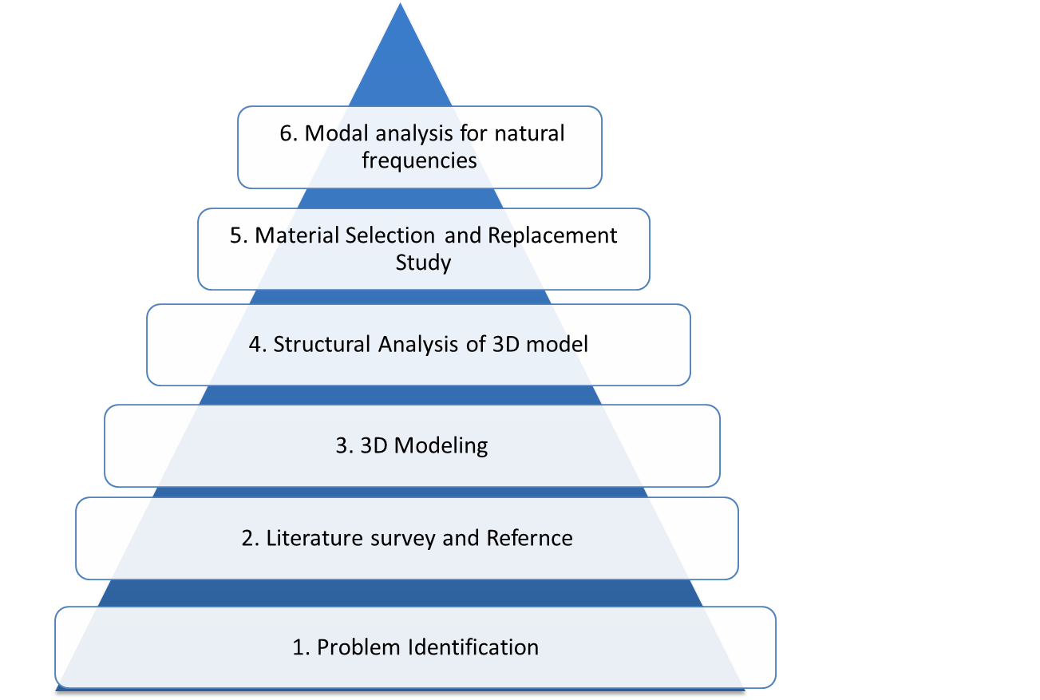
Methodology
5

Slide 6
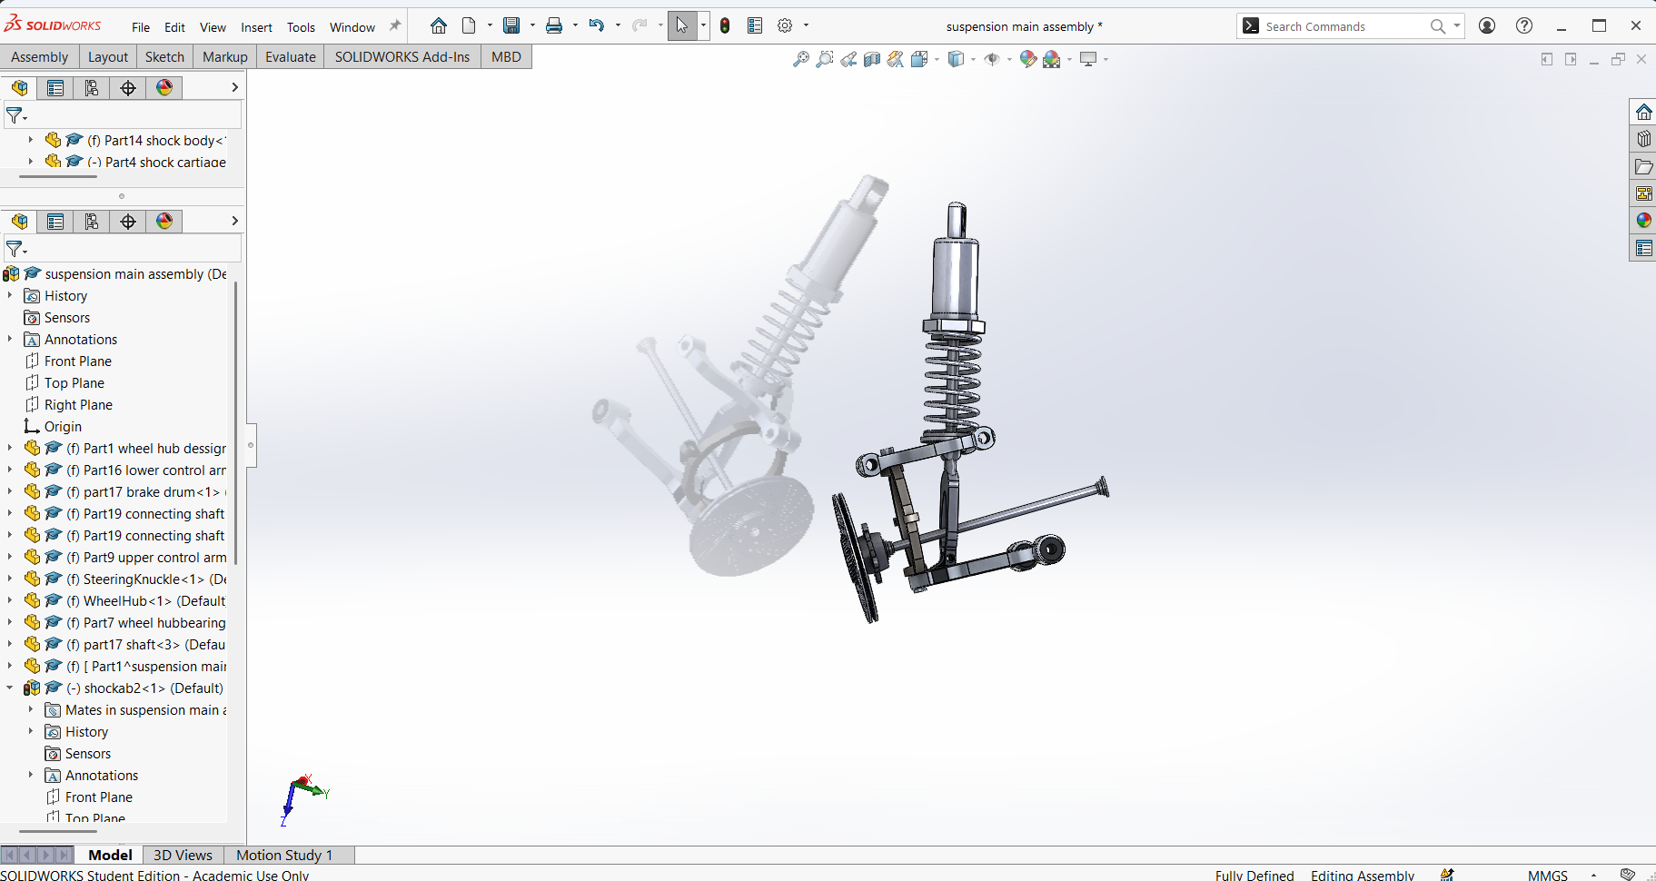
Refrences
Source: GRABCAD
Source website :grabcad.com/library/audi-double-wishbone-suspension-system-1 6

Slide 7
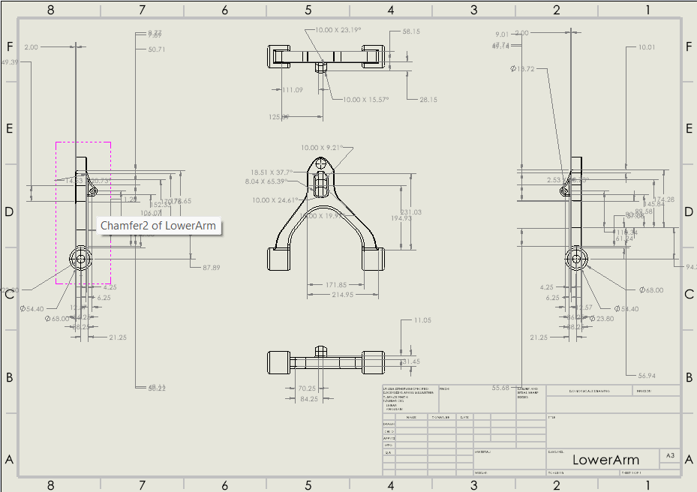
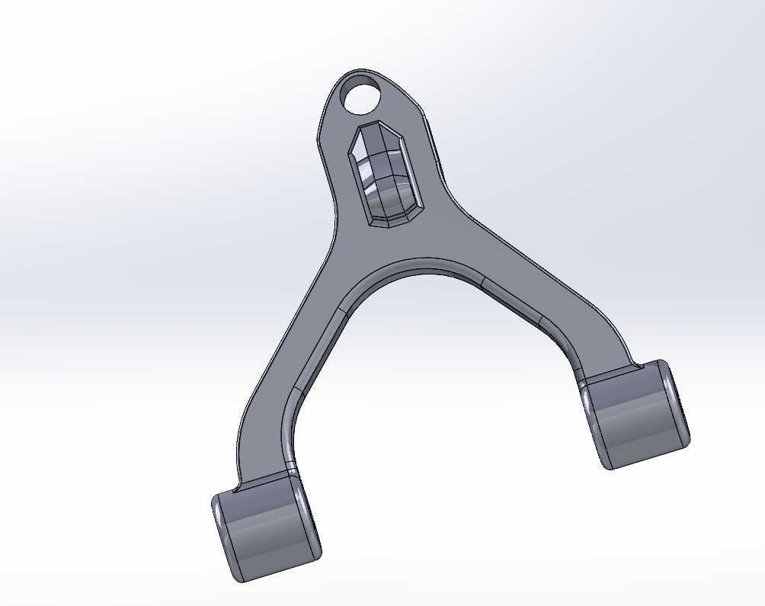
2d Dimensions
Lower control arm 7

Slide 8
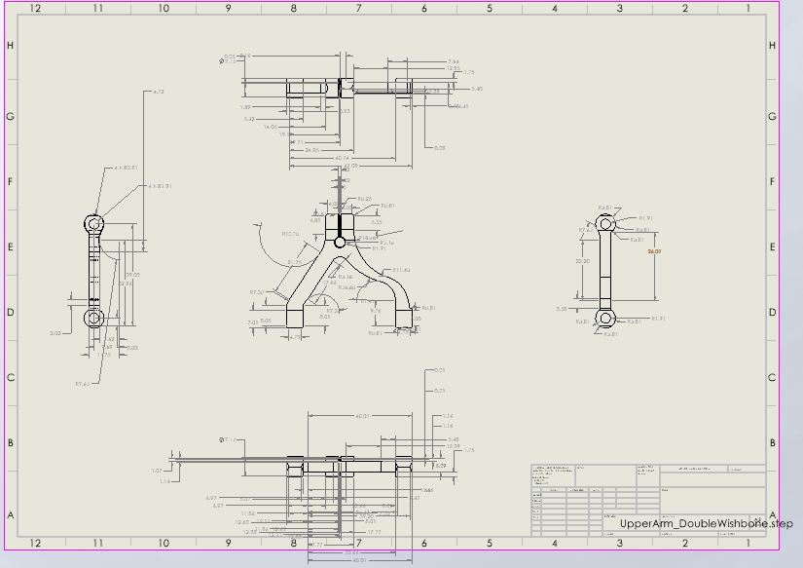
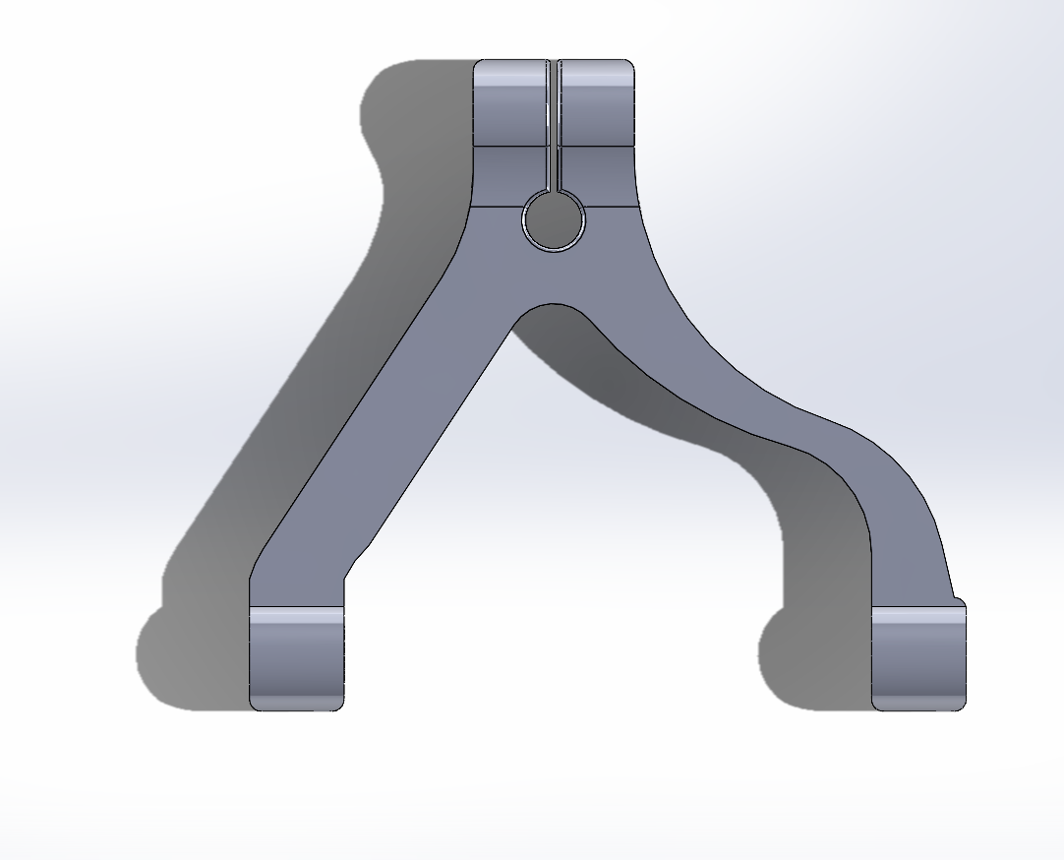
2d Dimensions
Upper control arm 8

Slide 9
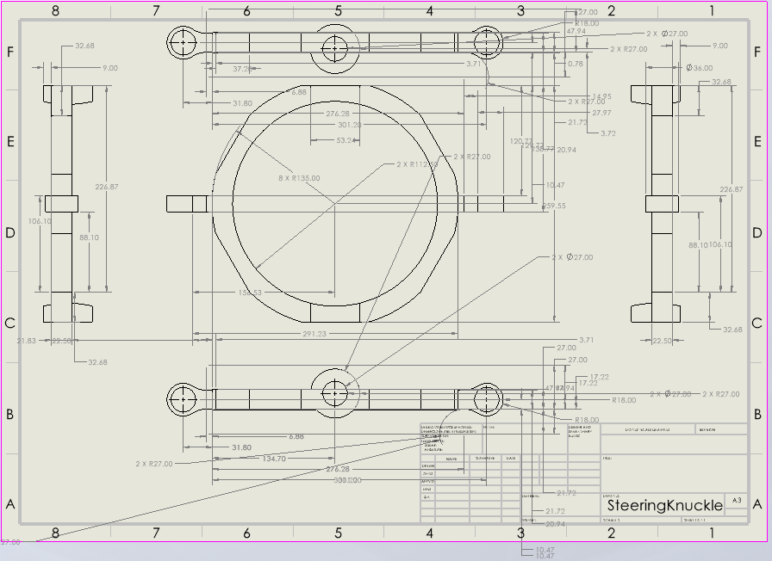
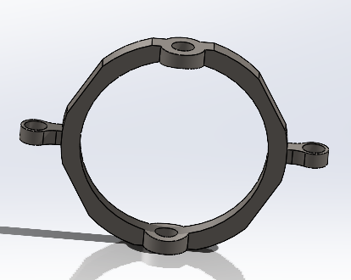
2d Dimensions
Steering knuckle 9

Slide 10
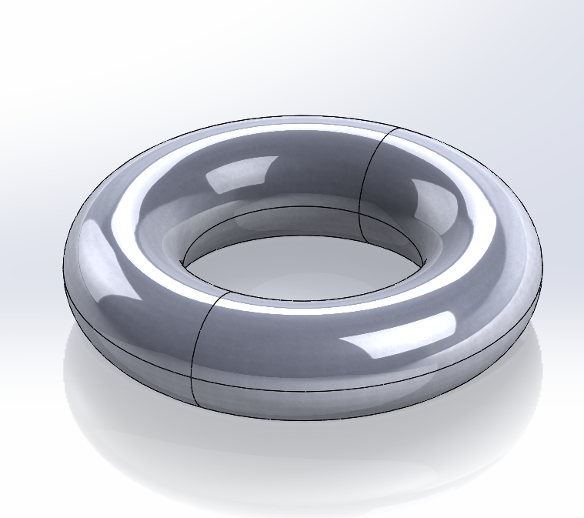
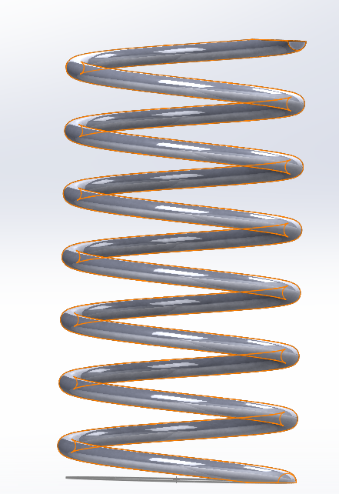
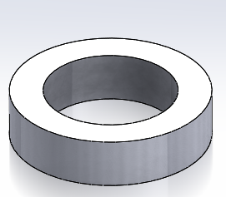
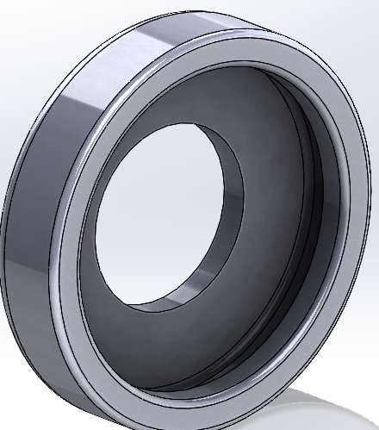
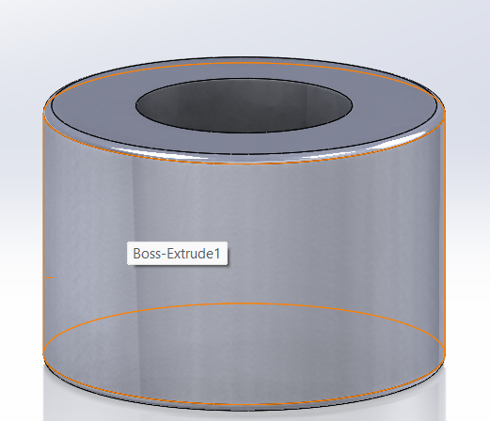
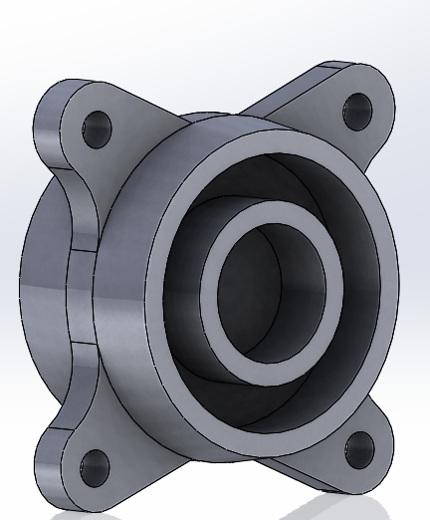
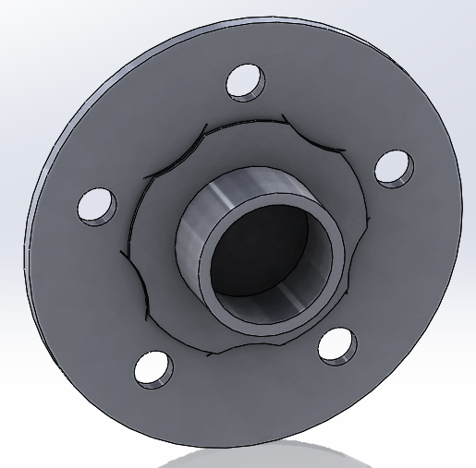
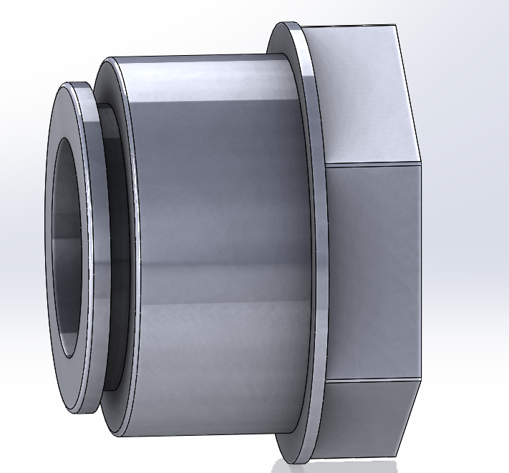
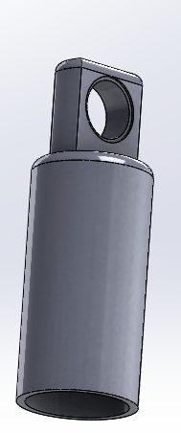
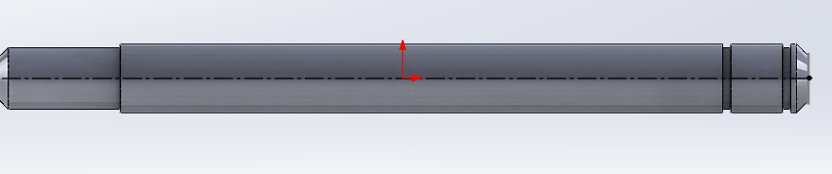
3D Design
O Ring Spring wheel hub design Shock Cartiage Cover Spacer
Shaft Wheel Hub Bearin Wheel Hub Shock Carriage Shock Body
10

Slide 11
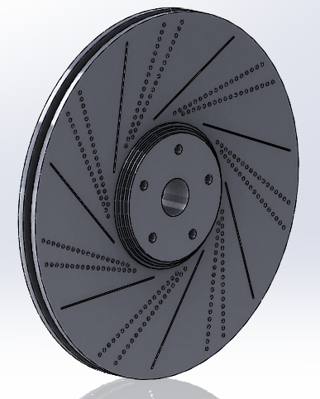
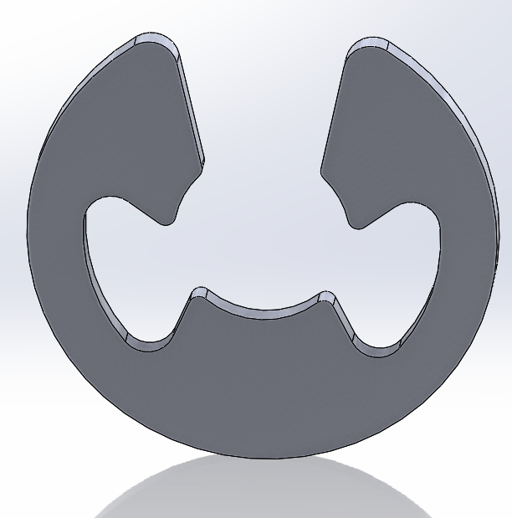
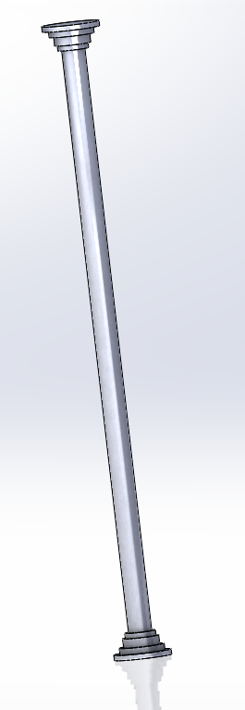
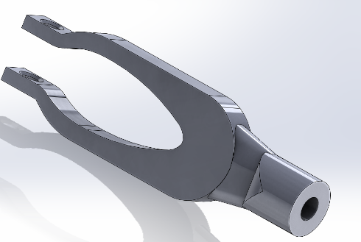
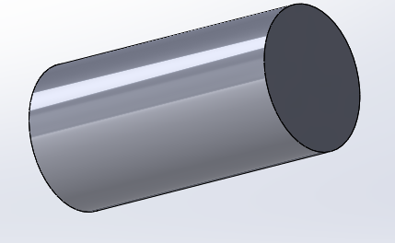
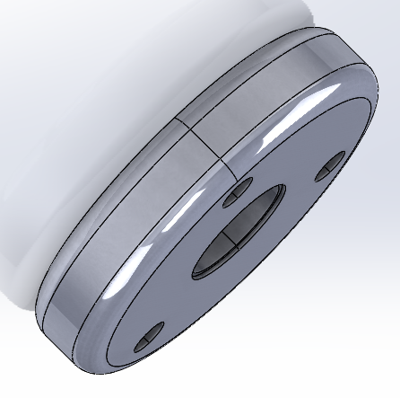
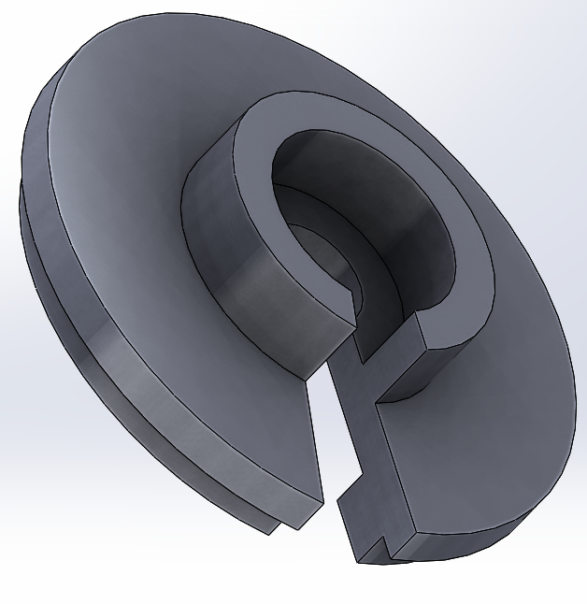
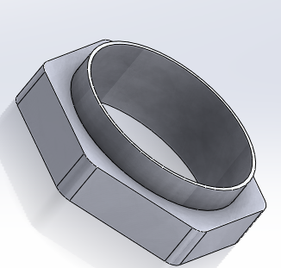
3D Design
Shaft Connecting Shaft U End Brake Drum E Clip
Adjusting Nut Piston Spring Cup
11

Slide 12
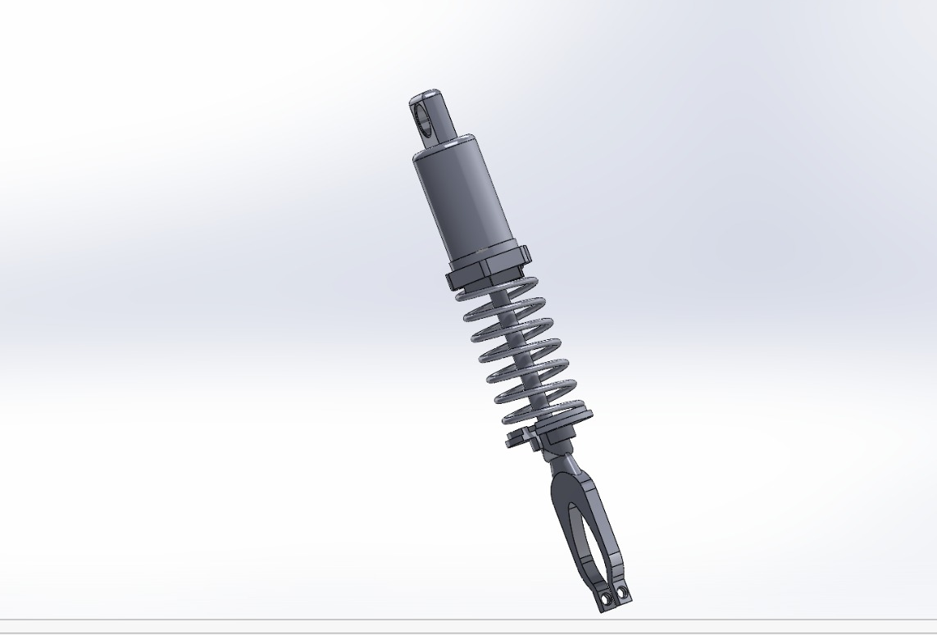
3D Design
Shock Absorber The Suspension System
12

Slide 13
3D design
Complete double wishbone suspension system was designed using SOLIDWORKS
The complete assembly was developed to simulate a real automotive suspension system
Main focus of the project was on:
  Upper control arm
  Lower control arm
  Spring in the shock absorber
Material optimization was performed by changing the materials of the control arms and spring while keeping other components as Structural Steel 13

Slide 14
3D design
The completed suspension assembly designed in SOLIDWORKS was imported into ANSYS for static structural analysis.
The analysis provided:
  Total deformation
  Equivalent (Von Mises) stress
  Structural behavior under static loading
The complete suspension assembly was also analyzed under total loading conditions.
Meshing was performed to obtain accurate stress and deformation results.
14

Slide 15
Car Weight=1750 Kg
4 person in car(70 kg each)= 280 Kg
Total Mass= 2030 Kg
Converted in Newton =2030*9.81=19,914 N
Wheel Load =Total Load/ no of Wheel=19,914/4=4978.5 N
Dynamic Load=Dynamic Load *Wheel Load=1.44*4978.5=7170N
Spring Force=motion factor*Wheel Load=0.69*4978.5=3435N
15
Load Calculation

Slide 16
Load Remaining For Control Arm:
Load Arm=Dynamic Load-Spring
=7170-3435
=3735N
Lower Arm(60%)=0.60*3735
=2241N
Upper Arm(40%)=0.40*3735
=1494N
Where:
Dynamic load-It is a time-varying force acting on the suspension component due to road irregularities, vehicle acceleration, braking, and cornering during motion.
Motion ratio- It is the ratio of the suspension component's displacement to the wheel's displacement, used to relate wheel forces and movements to the spring/damper in the suspension system.
16
Load Calculation

Slide 17
Materials
Material preferred:
Taken care of above mentioned parameters we have preferred the following materials :
For control Arms: AA6061 T6,AISI 4130
For a Spring: Chromium steel (CrSi), 65Si7 (spring steel)
17

Slide 18
Material Properties
Materials used for Control Arms
18
Properties | AA6061-T6
Young’s Modulus | 69 Gpa
Density | 2700 kg/m^3
Yield Strength | 276 Mpa
Poission’s Ratio | 0.33
Ultimate Strength | 310 Mpa
Properties | AISI4130
Young’s Modulus | 205 Gpa
Density | 7850 Kg/m^3
Yield Strength | 460 Mpa
Poission’s Ratio | 0.3
Ultimate Strength | 670 Mpa

Slide 19
Material Properties
Materials used for Spring
19
Properties | Chrome Silicon Steel
Young’s Modulus | 2.01 *10^11 pa
Density | 7800 kg/m^3
Yield Strength | 1000 Mpa
Poisson’s Ratio | 0.3
Ultimate Strength | 1800 Mpa
Properties | 65Si7
Young’s Modulus | 210 Gpa
Density | 7850 Kg/m^3
Yield Strength | 250 Mpa
Poisson’s Ratio | 0.266
Ultimate Strength | 460 Mpa

Slide 20
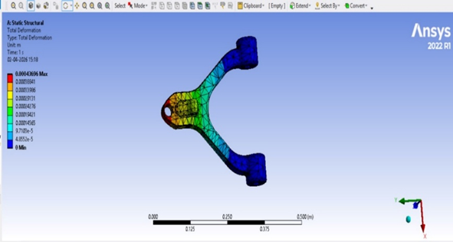
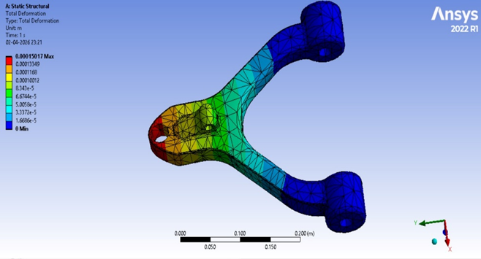
Analysis
Static structural analysis was performed on the control arm using ANSYS by fixing both mounting ends and applying load at the top joint region to simulate actual suspension loading conditions.The load applied is 2241N
The total deformation in AA6061 T6 is 0.43696mm The total deformation in AISI 4130 is 0.15017mm
20

Slide 21
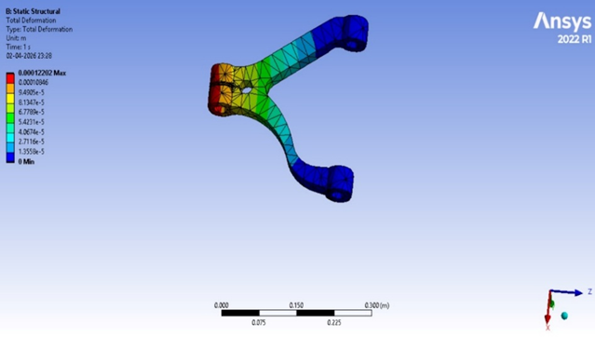
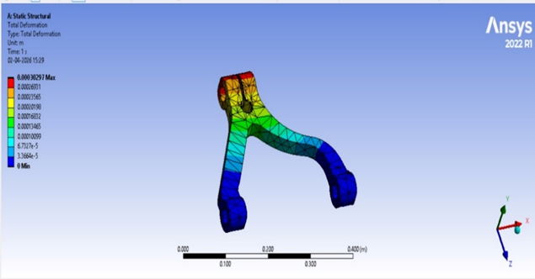
Analysis
The total deformation in AA6061 T6 is 0.30297mm The total deformation in AISI 4130 is 0.12202mm
The load applied on the upper control arm is 1494N
Two different materials, AISI 4130 Chromoly Steel and AA6061 Aluminium Alloy, were analyzed to compare their deformation characteristics under the same loading condition.
The deformation obtained in both materials was very small, indicating that the control arm design has sufficient stiffness 21

Slide 22
Analysis
These are very small deformation values for a suspension control arm under static loading.
Reason:
The control arm geometry is rigid.
Both materials have good structural strength.
The mounting ends are fixed, which reduces displacement.
AA6061 shows more deformation because aluminum has lower Young’s modulus
AISI 4130 deforms less because steel is stiffer.
22

Slide 23
Analysis
Chrome silicon steel and 65Si7(Silicon Manganese alloy spring steel) are the materials used for the spring in the shock absorber shown here. We analyzed only the spring by changing its materials, while keeping the remaining parts at their default materials (structural steel) in the ansys
In the shock absorber, the two end points (below) are fixed. The applied force on top is 3435 N. Here, we are only focusing on the spring deflection.
23

Slide 24
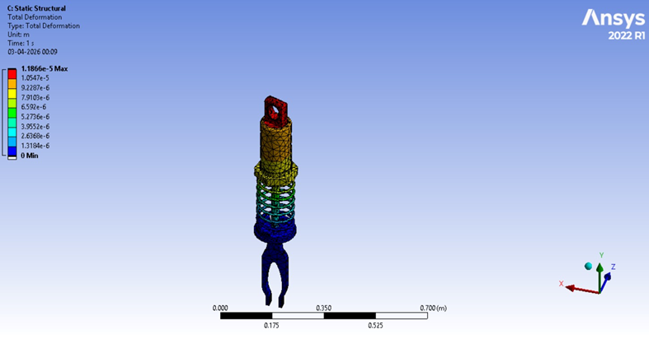
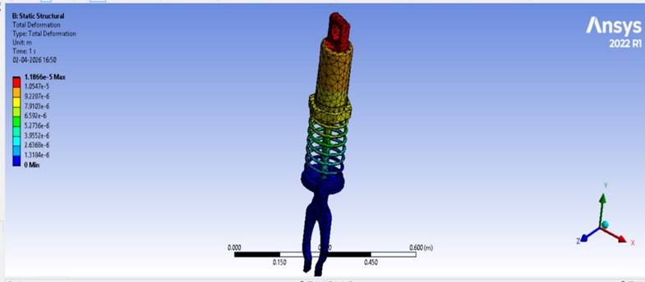
Analysis
Shock Absorber of spring Chrome silicon steel and 65Si7 is 0.011866 mm
The load applied here is 3435N
Note: Here, the material was changed only for the spring, while the default material for the other components was kept as structural steel, since our focus was mainly on the spring.
24

Slide 25
Analysis
The forces applied to the individual components are considered together for the entire system, as shown below. These include the forces acting on the top of the shock absorber and on both the upper and lower control arms. The fixed supports remain the same as mentioned earlier, and the magnitude of the applied forces is also unchanged. Since the study focuses on the control arms and the spring, only the materials of these components were varied, while all other components were kept as the default material (structural steel)
The force applied
  Lower control arm – 2241N
  Upper control arm – 1494N
  Shock absorber - 3435N
                ` 25

Slide 26
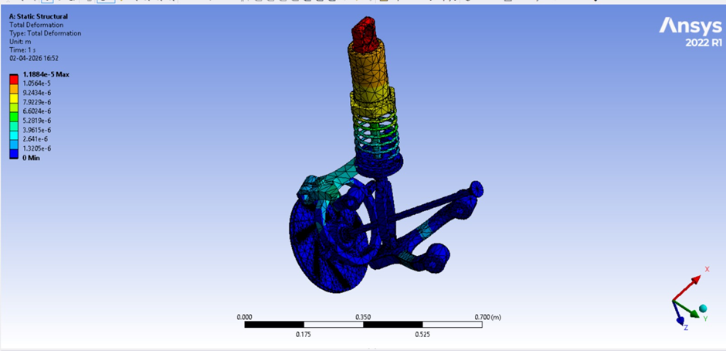
Analysis
Total deformation
Max deformation: 0.0119mm
Min deformation: 0.00132mm
Equivalent Stress
Max stress: 10.56 N/mm^2
Min stress: 1. 173 N/mm^2
26
Combination of AA6061-T6 and Chrome Silicon Steel

Slide 27
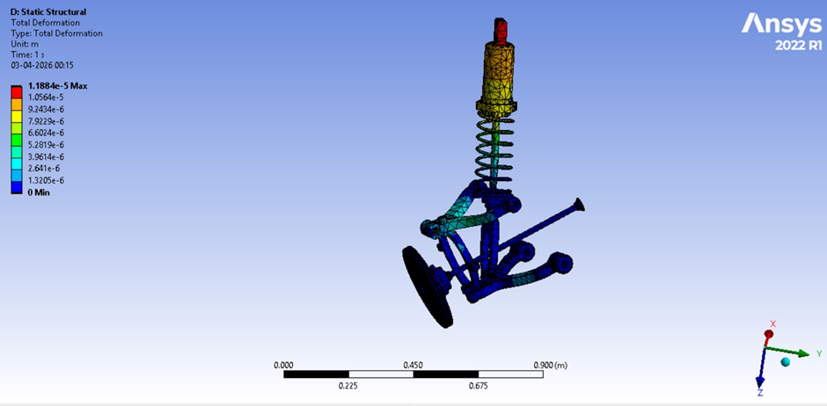
Analysis
Total deformation
Max deformation: 0.011884mm
Min deformation: 0.0013205mm
Equivalent Stress
Max stress: 10.556 N/mm^2
Min stress:1.1729 N/mm^2
27
Combination of AISI4130 and 65Si7

Slide 28
Results
Both material combinations show almost identical deformation values because we changed only the components we are focusing but others are default material(structural steel).
Comparsion & Interpretation
AISI 4130 : Higher strength, better load carrying capacity
AA6061-T6 : Lightweight, good corrosion resistance
65Si7 spring steel : Higher stiffness and fatigue strength
Cr-Si steel : Good shock absorption and durability
28

Slide 29
Results
Best Combination (Recommended):
AISI 4130 (Control Arm) + 65Si7 (Spring)
Reason:
Higher strength and stiffness
More suitable for heavy-duty and high-load conditions.
29

Slide 30
Conclusion
The static structural analysis of the wishbone suspension system was carried out using ANSYS to evaluate the deformation behavior under applied loads. considering strength, stiffness, the combination of AISI 4130 for the control arms and 65Si7 for the spring is found to be more suitable for high-load conditions.
Hence, this material combination is recommended for better durability and overall performance of the suspension system, while AA6061-T6 can be preferred when weight reduction is a priority.
30

